Slide 1
Planning Advisory Group Presentation – Chapter 330 Summary
June 28, 2022

Slide 2
Agenda:
Rebuild Plan – Chapter 330
Reliability Performance
Grid Planning

Slide 3
Rebuild Plan – Chapter 330

Slide 4
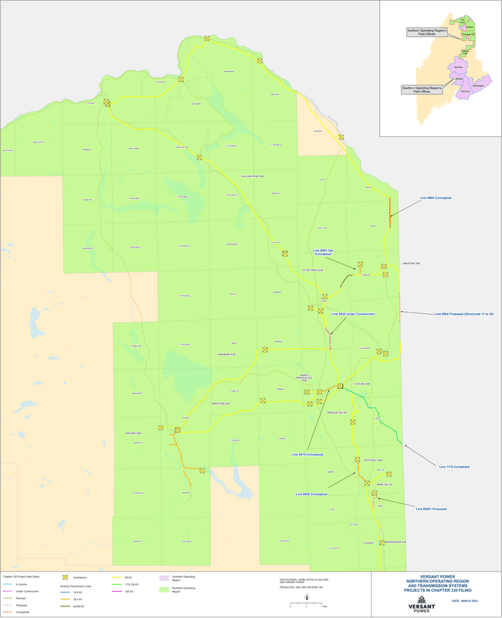
Northern Maine Transmission System

Slide 5
Transmission Planning Collaboration
  Adjusted based on customer feedback
  Intent: spread out remaining required MPD rebuild plan over 15-20 years (total rebuild program will span nearly 30 years)
  Final plan subject to enhanced inspection findings (drone, resistograph, climbing, ultrasonic, thermal)
  Line and targeted line segment rebuilds will be necessary

Slide 6
Chapter 330 Plans & Adjustments

Slide 7
2021 Project Work Completed
Line 1176 Phase 2: Structures 42 to Border
    (Border – Ladner Rd. to 1A – Easton)
Line 1176 Phase 3: Structures 3 to 41
    (Easton to Flos Inn, Presque Isle)
Line 6930 Dow to Maysville Siding Roads
(Caribou – west bank of river;
construction more than 3/4 complete)

Slide 8
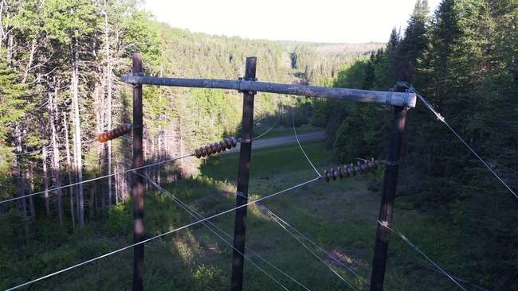

Line 1176 Pre-Rebuild Condition

Slide 9
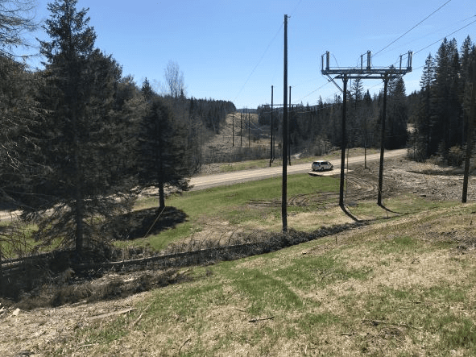
Line 1176 Post Rebuild
Structure rebuilt with an in-line switch for sectionalizing, ROW widened, lightning protection installed.
Notice the fir tree that fell from outside of the cleared ROW with no affect

Slide 10
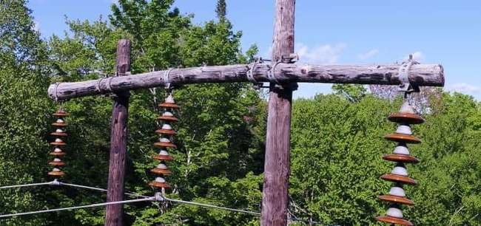

Line 1176 Pre-Rebuild Condition

Slide 11
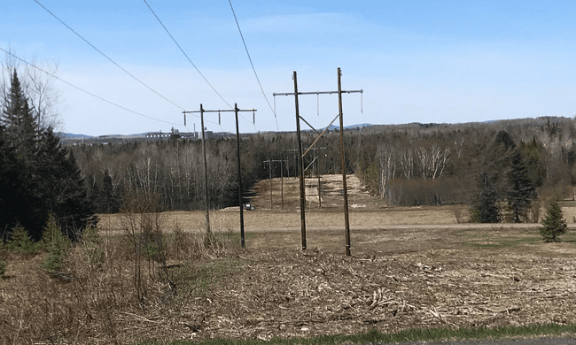

Line 1176 Post Rebuild
New structures are taller with steel crossarms, polymer suspension insulators, cross bracing for improved structure stability and overhead OPGW static wire for lightning protection

Slide 12
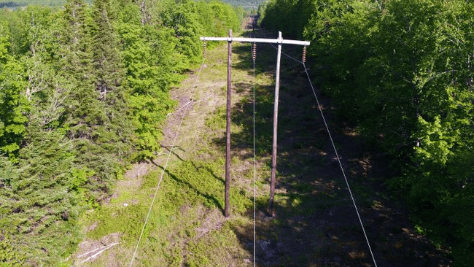
Line 1176 Pre-Rebuild

Slide 13
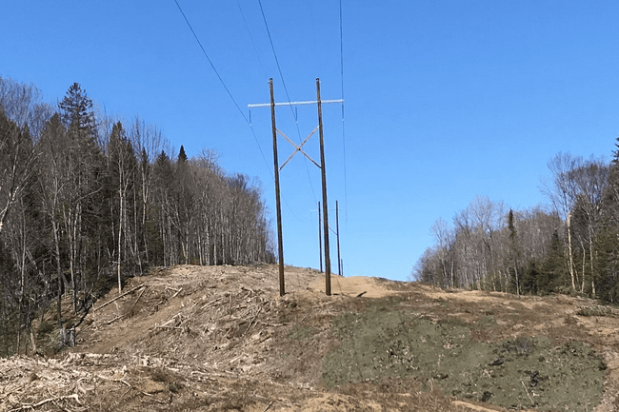
Line 1176 Post Rebuild
Long term plan to widen ROW via easements improves reliability

Slide 14
Emerging Issues
System Condition
  Line 6904 (Limestone to Tinker)
  Line 6920 (Mars Hill to Mullen)

Slide 15
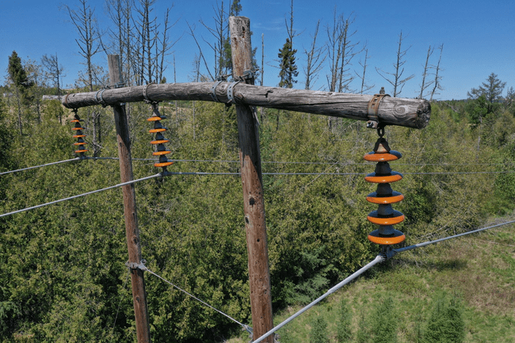
Line 6904 Emergency Crossarm Replacements

Slide 16
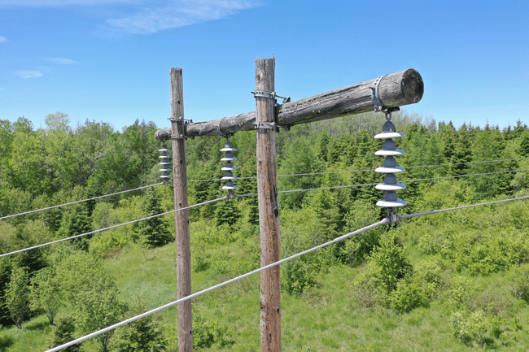
Line 6904 Condition continued…

Slide 17
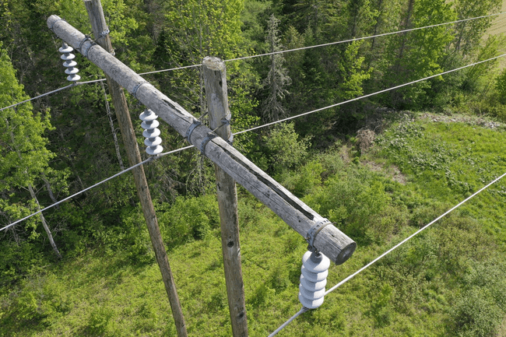
Line 6904 Condition continued…

Slide 18
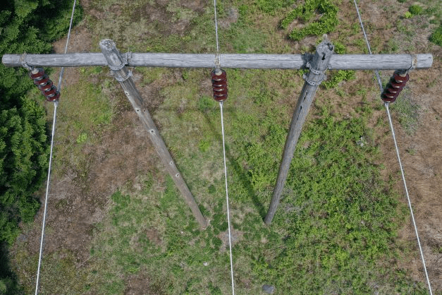
Line 6920 Condition

Slide 19
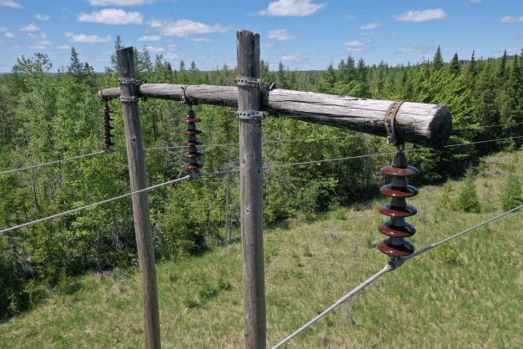
Line 6920 Condition continued…

Slide 20
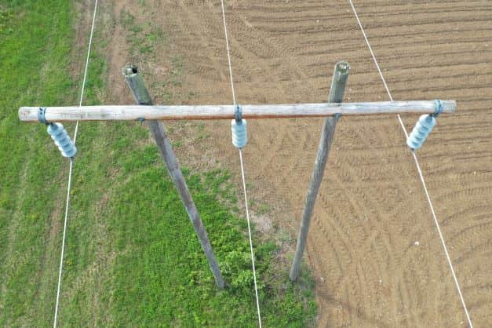
Line 6920 Condition continued…

Slide 21
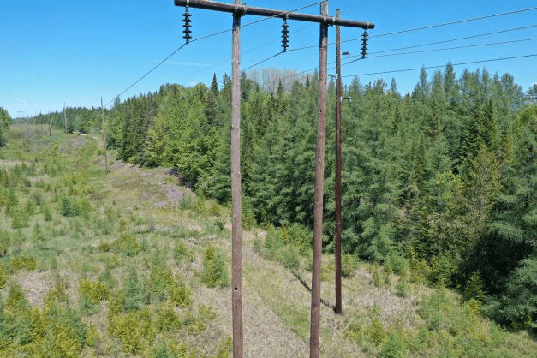
Line 6920 Condition continued…

Slide 22
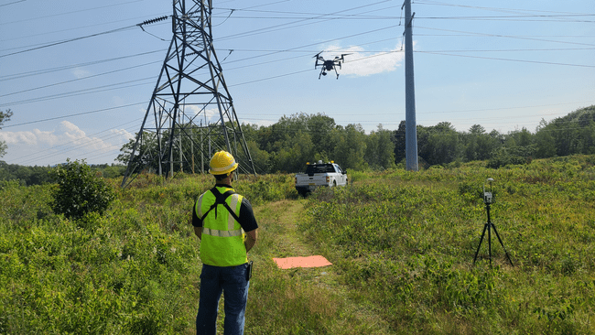
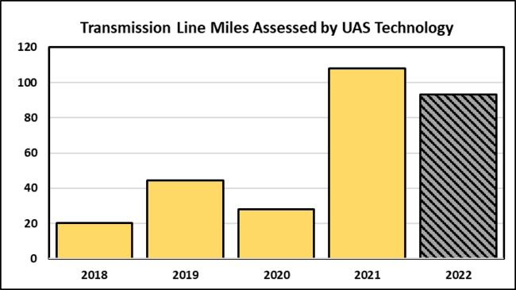
Enhanced Inspection Methods - Drones
Overhead images provided by drones are providing asset managers with a new and different way of assessing asset condition

Slide 23
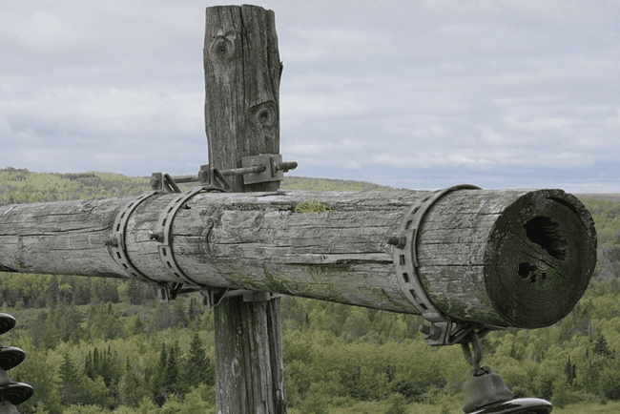
Example of a Closeup Drone Inspection Photo

Slide 24

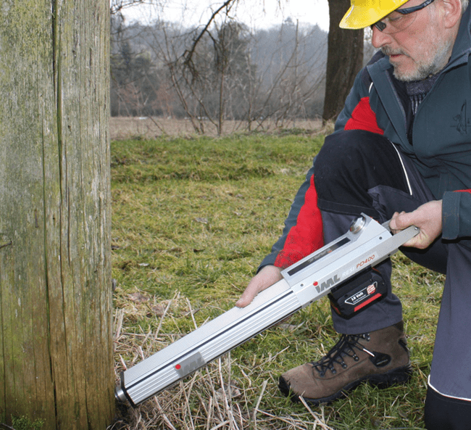
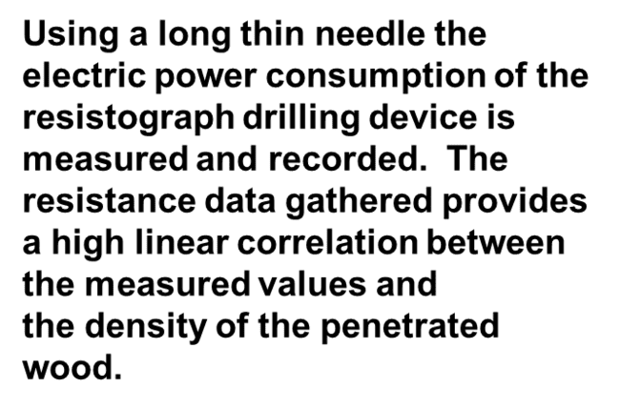
Enhanced Inspection Methods continued…Wood Pole Strength Assessment using Resistograph

Slide 25
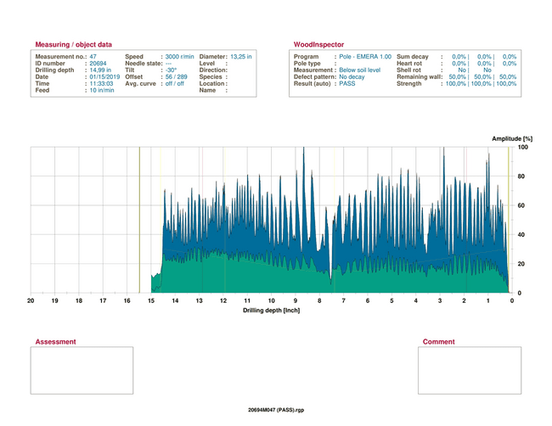
Resistograph Plot - Wood Pole in good condition

Slide 26
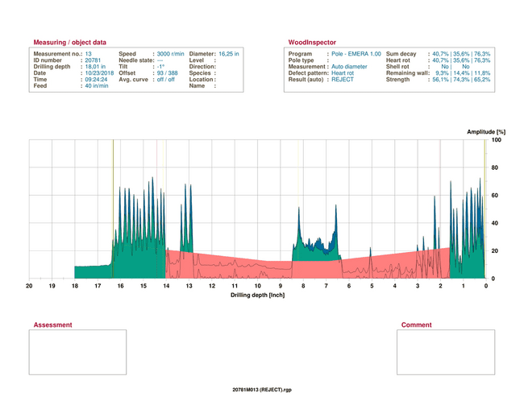
Rejected Wood Pole – Heart Rot

Slide 27
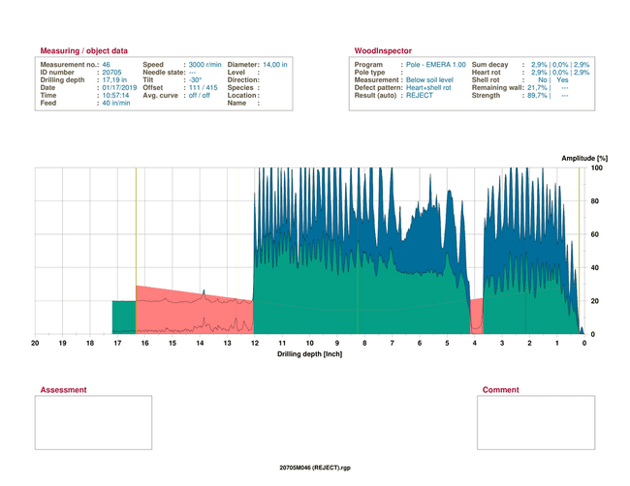
Rejected Wood Pole – Heart Rot & Shell Rot

Slide 28
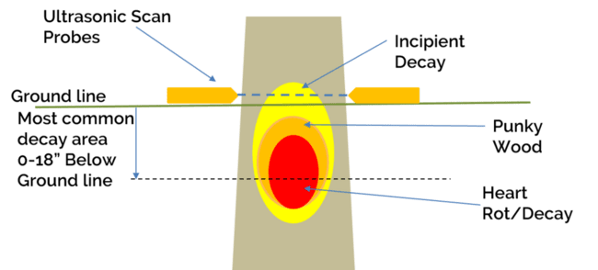
Wood Pole Ultrasonic Pilot Program

Slide 29
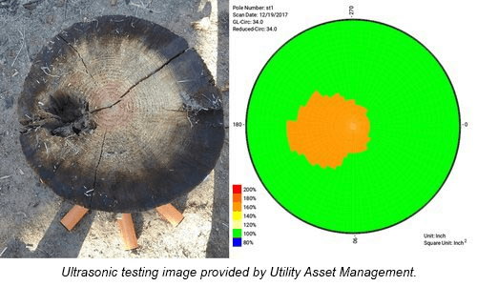
Wood Pole Ultrasonic Pilot Program

Slide 30
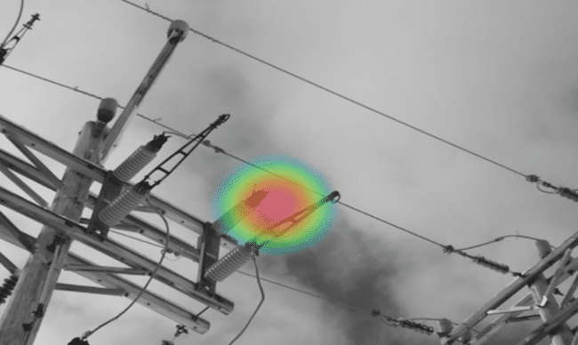
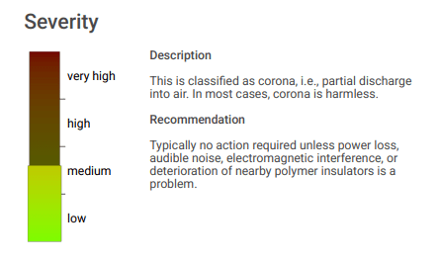
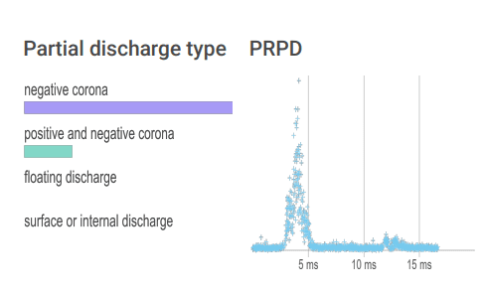
Handheld Acoustic Condition Assessment

Slide 31
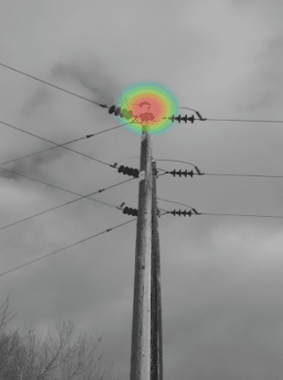
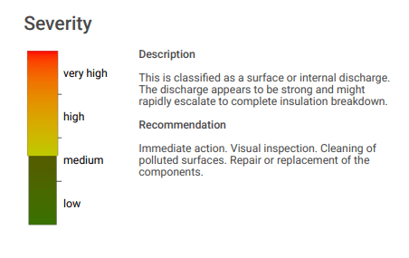
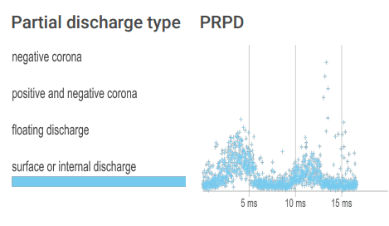
Handheld Acoustic Condition Assessment

Slide 32
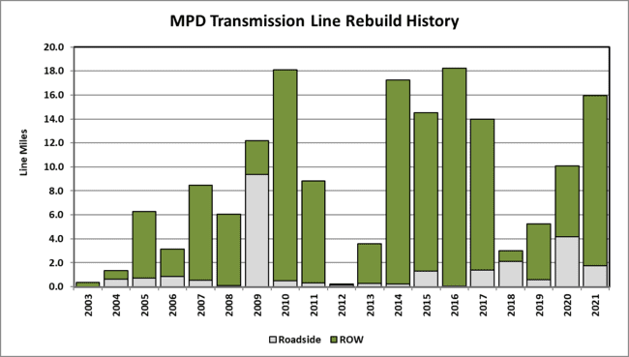
20-Year MPS Transmission Line Rebuild History

Slide 33
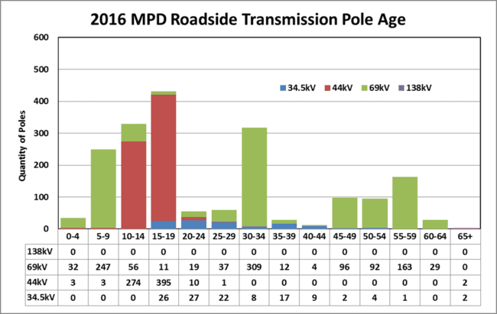
MPD Roadside Transmission Line Pole Age - 2016

Slide 34
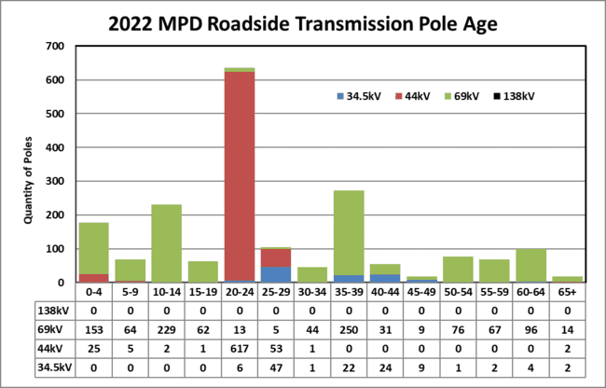
MPD Roadside Transmission Line Pole Age – 2021

Slide 35
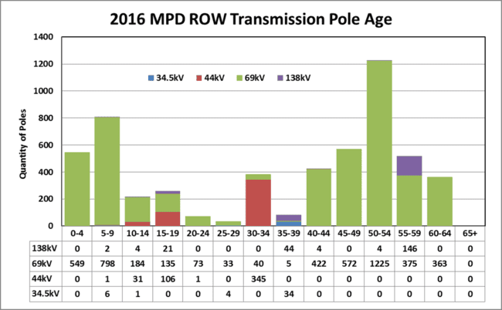
MPD ROW Transmission Line Pole Age - 2016

Slide 36
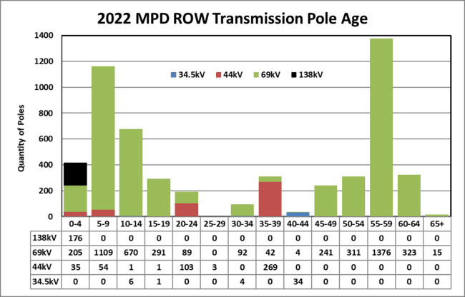
MPD ROW Transmission Line Pole Age - 2021

Slide 37
Chapter 330 Summary
 | 2019 | 2020 | 2021 | 2022
Plan miles | 30 | 33 | 29 | 17
Average Miles per year | 6.1 | 6.7 | 5.9 | 3.3
Average Cost per year ($ M) | $4.2 | $5.3 | $4.6 | $2.6
Reasons for reduction:
Large project, Line 1176, is complete
Currently, no large projects in the 5 year plan – drives averages down (miles & cost)
Smaller projects: Line sections from 1.2 to 4 miles ($1.0 - $3.5 M)
Tap Line 69053 removed from plan
Notes:
Line 1176: total cost of $13.4 M vs Chapter 330 estimate total of $11.5 M. Increase is a result of Line 6901 issues when constructing 1176: Line 6901 tripped out twice – 2 reasons: 1. incorrect settings on Algonquin system transformer protection (corrected) and 2. insulator on Line 6901 above a gravel pit tracked over and faulted (dust). These issues slowed the project down resulting in requiring additional resources and cost to complete.

Slide 38
Reliability Performance

Slide 39
MPD Reliability Performance - Frequency

Slide 40
MPD Reliability Performance - Duration

Slide 41
MPD Overall Reliability Performance

Slide 42
Grid Planning

Slide 43
Integrated Planning Announcement
Integrating high penetrations of inverter based renewable generation into the grid creates challenges.
Here in the MPD, between existing units and today’s interconnection queue, we have more than 200 MW of such units – and we currently peak at about 100 MW.
Solar capacity alone would be more than 160% of the peak.
Notes:
The 2020 blackout’s in California occurred late in the day, the transition period, as the sun set and other resources were being brought on-line to take over from solar. At that time, California’s solar capacity was about 56% of their peak – obviously well under the number we’re talking about here.

Slide 44
Versant Integrated Grid Planning
Versant is initiating an Integrated Grid Planning (IGP) effort
Will use the PAG process to conduct that process, to get stakeholder feedback

Slide 45
GEO Report on Northern Maine
Versant Obligations: actively participate in policy making and facility state policy goals
Engage with and educate legislature and policy makers as part of the planning process
Versant’s intentions – the Northern Maine planning process via the PAG – were:
  Shared with the GEO
  Included in the N. Maine report…
  Which was accepted by the EUT (March 10th)

Slide 46
Planning Advisory Group – Integrated Plan
FERC approved Tariff specifies the process by which the Transmission Provider does system planning – an Advisory Group (PAG) is specified within that process.
Versant has held a PAG meeting annually given that Chapter 330 is required every year – more often than the Tariff requirement - Biennial meetings.
Versant has also invited a wide group of stakeholders to these meetings: the Tariff described PAG process however, is open to a defined group of 7 entities to assist.
Notes:
16 pages of the Tariff dedicated to the PAG process – Attachment R

Slide 47
PAG Entities
Transmission Owners – Liberty
Customers – TBD
Generators – TBD
Suppliers – TBD
Neighboring Trans. Providers & Control Areas - NBP
Regulatory Agencies – MPUC
Public Advocates – OPA
Governor’s Energy Office – GEO
  LD 1959
Notes:
“Each entity that participates shall have one member of the group”

Slide 48
Tariff Language
5.3 Discussion of Assumptions. Members of the Planning Advisory Group shall have the opportunity to question and discuss principal assumptions used in the planning process. The process shall be through meetings of the Planning Advisory Group. Such meetings, if appropriate, may be held via email or other solicitation of written comments.
Biggest controversies generally stem from assumptions used to conduct the study

Slide 49
Assumptions: Hourly/Seasonal Impacts
Load/growth forecasts
Generation/energy/DER forecasts
  June 21st is very different than December 21st
“8760” Analysis
Impact of droughts?
Days without sun?
Days without wind?

Slide 50
PAG Feedback
Transmission enhancements and expansions
Distribution requirements
Storage requirements
Voltage controls/Reactive Power support
Demand Response
Public Policy Requirements
Cost/rate impacts

Slide 51
Study/Modeling
Thermal analyses
Voltage analyses
Stability analyses
Time Series analysis
These system performance models will be run with and without potential reinforcement options to determine impact on system reliability
Expect hundreds of scenarios will be run
Expect to build a combined Transmission & Distribution system model

Slide 52
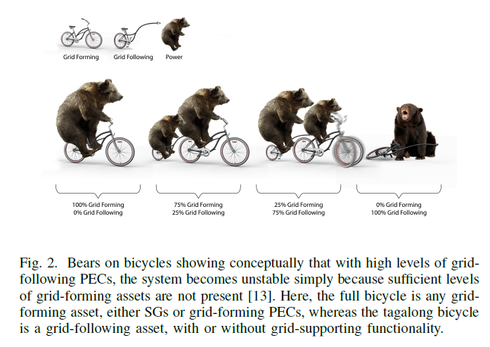
Inertia and Grid Forming vs. Grid Following

